Slide 1
Sensor and Actuator Data Processing with FPGA Atieh Nazariasl
Tuna Temiz SS 2021

Slide 2
Overview
Project Description
Literature Review
Implementation Process
Results and Discussion
Conclusions and Summary

Slide 3
Project Description
Project Goals
INS
PWM
Used Hardware
Zybo z7
Required Software
Xilinx Vivado Design Suite
Xilinx Software Development Kit (XSDK)

Slide 4
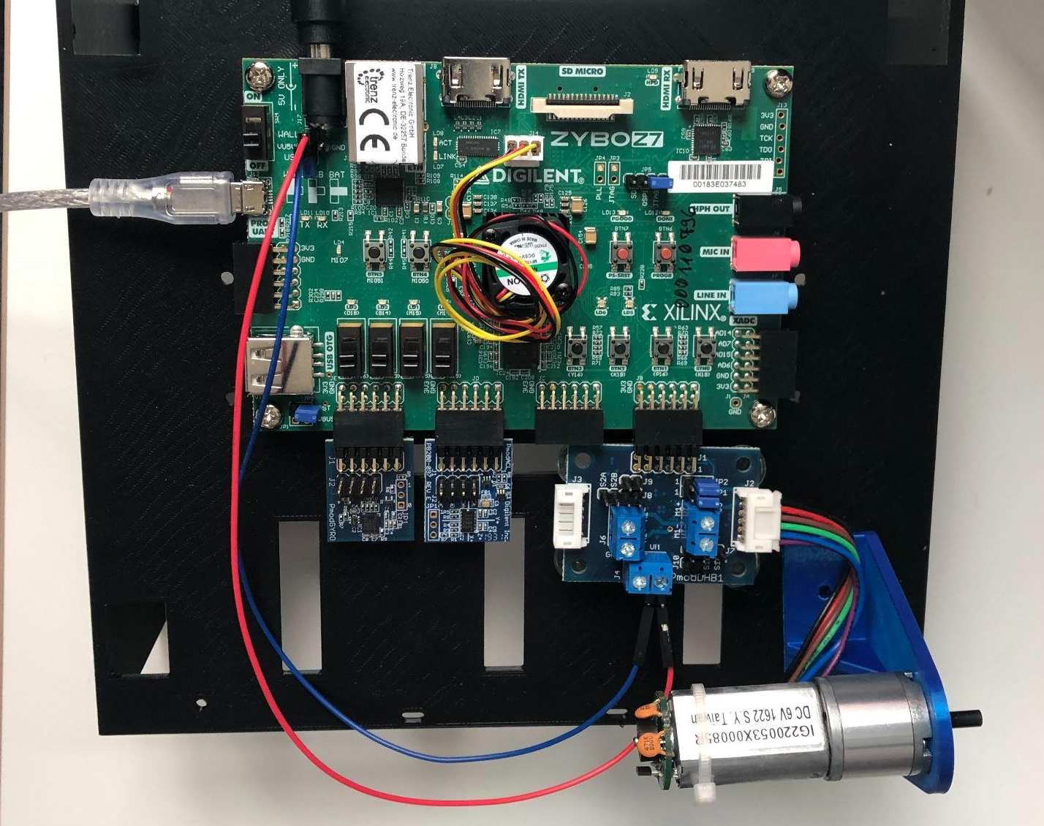
Used Hardware
Notes:
Development Board
Zybo Z7-20, Zynq-7000 ARM/FPGA SoC Development Board
Full support for Vivado, including tool integration, example projects and tutorials
667MHz dual-core Cortex-A9 processor with tightly integrated Xilinx FPGA
Pmod connectors for adding-on hardware devices
PMODs
PMOD DHB1 (Motor Driver)
PMOD GYRO (Gyroscope)
PMOD ACL (Accelerometer)

Slide 5
Introduction to INS
Main components of INS systems
The basic principles of INS systems
Position calculation
Angular position calculation
Limitations of inertial navigation
Sources of errors in inertial navigation
Error compensation methods

Slide 6
INS Goals
Gyroscope Calibration
Gyroscope sampling
Error compensation for Gyroscope
Rotation angle calculation
Accelerometer sampling

Slide 7
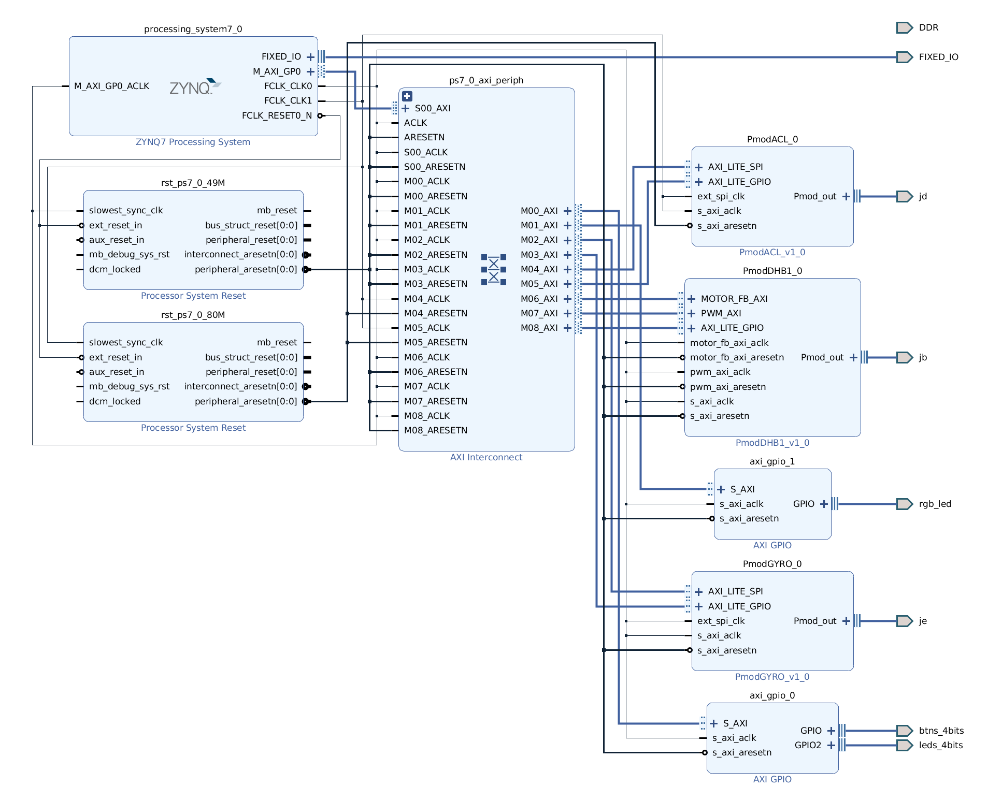
Software Configuration

Slide 8
INS Implementation Process
Used tutorials
Hello World tutorial
Getting Started with the Vivado IP Integrator
Getting Started with Digilent Pmod IPs
Overcome challenges
Problems in UART communication
Problems in Pmod design
Problems in Pmod communication

Slide 9
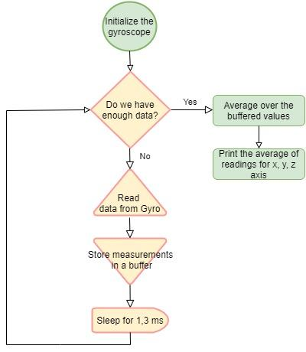
Calibration
The process of estimating the mean drift value
The overall flow of the program

Slide 10
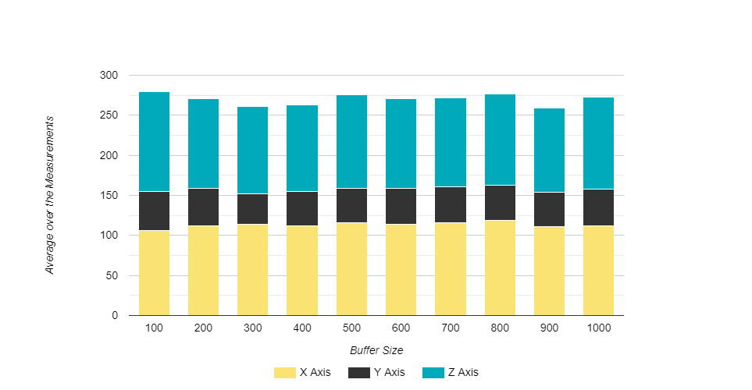
INS Parameter Settings
Calibration Buffer Size
Sleep time

Slide 11
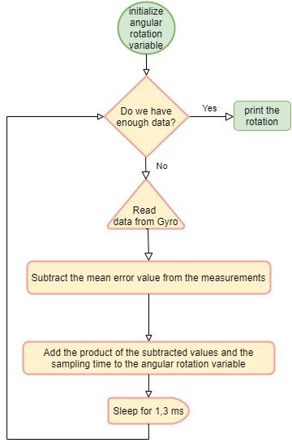
Angle Calculation
The process of angular rotation calculation

Slide 12
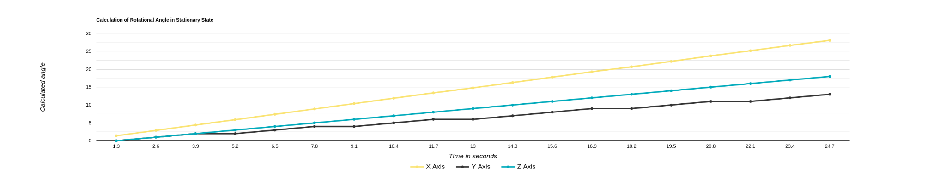
Gyroscope Calibration Results
Calculated angular rotation with no calibration

Slide 13
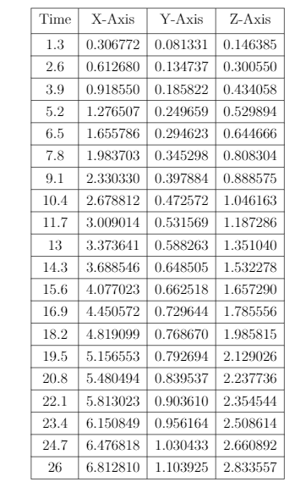
Gyroscope Calibration Results
Deviations of the calibrated means with no movement

Slide 14
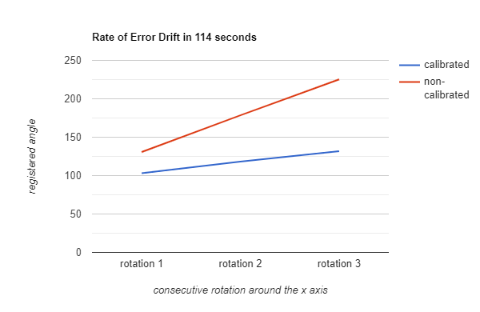
Gyroscope Calibration Results
Comparison of the results during movement

Slide 15
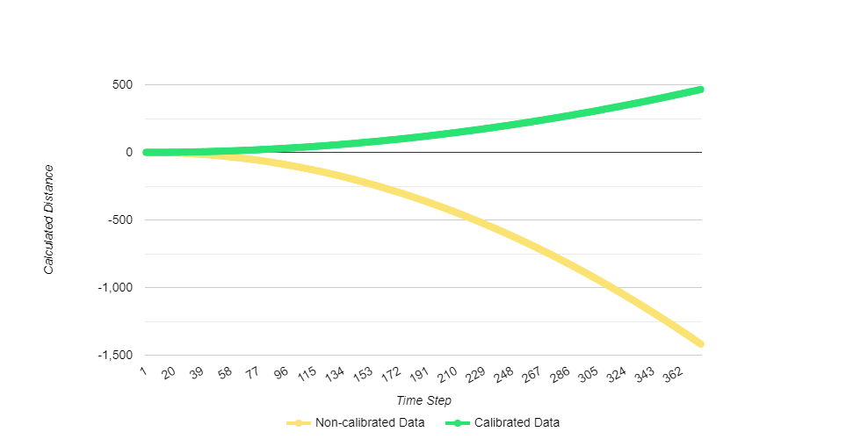
Accelerometer Measurements
Accelerometer Measurements

Slide 16
PWM Goals
Creation of hardware and software configuration
Repurposing or creating the required functionalities
Configuring the functionalities to be controlled through user input
Testing of behaviour

Slide 17
Used Hardware
DC Motor/Gearbox
Custom 6V Motor with rugged, heavy duty construction
1:53 Gear Ratio
Includes encoder for sensing rotation and speed
Suitable for use with the Digilent Mechatronic system or in custom applications

Slide 18
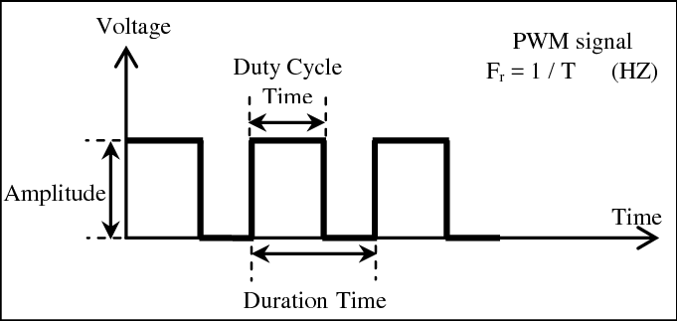
Introduction to Motor Controllers
PWM signal with its two basic time periods [2]
PWM
Open-loop Control

Slide 19
PWM Implementation Process
Two main goals;
acquiring the necessary functionalities for the motors
operation through console
Necessary include files;
headers belonging to the PMOD
those necessary for the UART
provided by Digilent Inc. and Xilinx respectively

Slide 20
PWM Implementation Process
Inline function and parameter declarations made. Can be changed with ease.
Two main bodies of code repurposed;
example code for the PMOD
another Xilinx example for UART
Function prototypes are declared, then variable definitions

Slide 21

PWM Implementation Process
An array for the storage of these characters is defined
Also integer values for;
the number of sensor edges,
speed (duty cycle percentage)
to store the total distance travelled

Slide 22
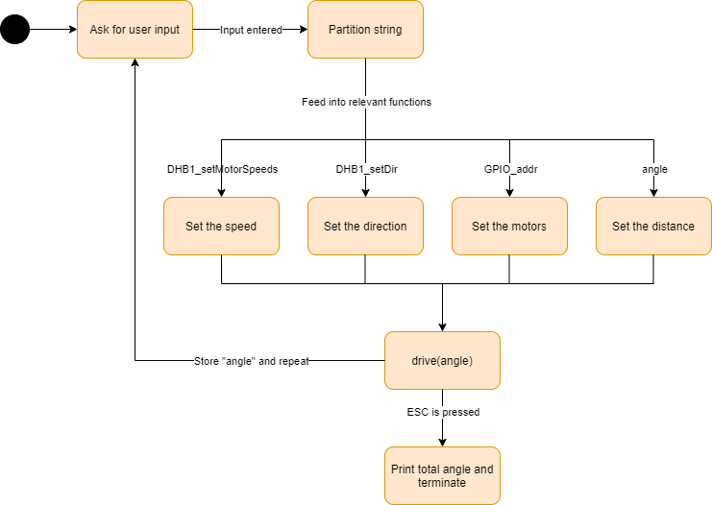
PWM Implementation Process
When sensed edges equal to the defined value;
clears position counter
disables motor
Can be repeated multiple times

Slide 23
Results of PWM
Currently, can set the speed, direction and distance to be traveled by the user
Tests had to be made for accurate functionality
External power applied to the PMOD was within operational parameters, all the observations made at room temperature

Slide 24
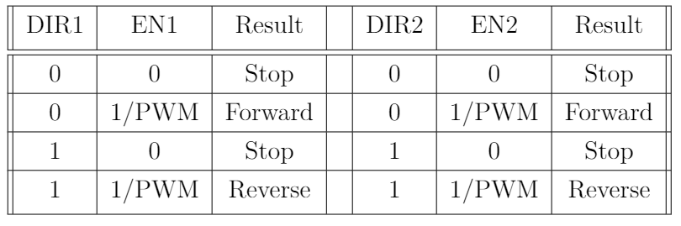
Results of PWM
For tests enabled and disabled the pins on the PMOD DHB1 to see if observations are correct

Slide 25
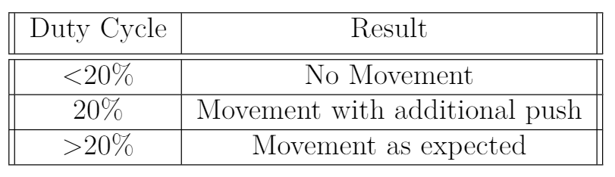
Results of PWM
The disabling, sleep and enabling of the motor took approximately 0.4 seconds
Duration is mainly due to the disabling of the motor; safeguard against short circuits

Slide 26
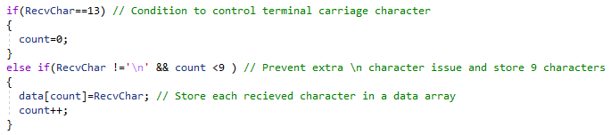
Results of PWM
Can be adapted to any hardware configuration if using the same PMOD
Possible improvements to be made are mentioned in the following slides

Slide 27
Future Development
Implement Kalman filter for error compensation in INS
Integration of the INS solution with GPS measurements
Add error messages, travel distance limit
Interruption functionality, more intuitive user interface

Slide 28
Conclusion
Successful implementation of software solutions on an FPGA
Estimation of drift error in accelerometer and gyroscope
Suggestion of error compensation methods for INS
Implementation of a pulse width modulator
Implementation of a user interface to control the speed of vehicle

Slide 29
Summary
Introduction to inertial navigation and pulse width modulation
Project Description
A Detailed Explanation of the Implementation process
Numerical and Analytical Results
Conclusions and Future Work

Slide 30
References
Barr, Michael: Pulse width modulation. In:Embedded Systems Programming 14 (2001), Nr. 10, S. 103–104
Mohamed, Mokhtar & Elmahalawy, Ahmed & Harb, Hany. (2013). Developing the pulse width modulation tool (PWMT) for two timer mechanism technique in microcontrollers. 148-153. 10.1109/JEC-ECC.2013.6766403.
Britting, Kenneth R.:Inertial navigation systems analysis. Wiley-Interscience, 1971
Herman, Stephen L.:Understanding Motor Controls. Cengage Learning, 2012
Fabian Hanke, B. S.:Ego and Object Motion Estimation. Munich, Bavaria,Germany, Technical University of Munich, Diplomarbeit, June 2018
Johns, Kenneth A.:Inertial Navigation Systems. University Lecture, 2009
Kelly, Alonzo:Modern Inertial and Satellite Navigation Systems. Carnegie Mellon University, 1994
Nichols, Timothy A.:Propagation of Sensor Noise in Navigation Equations and High Accuracy Dynamic Calibration of Sensors Accuracy Dynamic Calibration of Sensors. Rochester, New York, United States of America, June 2016

